Slide 1
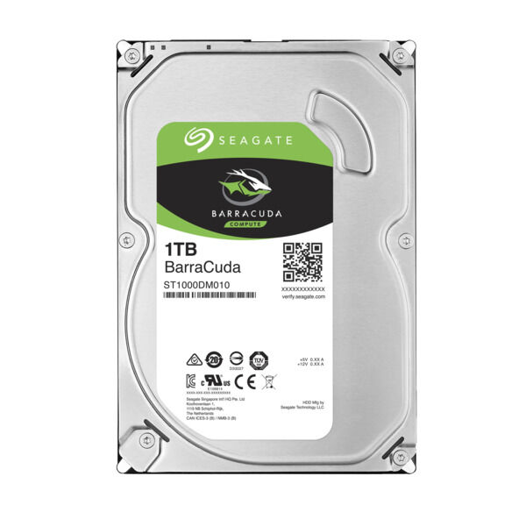

External Memory
Yuemin Ding
Tecnun, University of Navarra
Fall, 2021

Slide 2
Outline
Magnetic disk
Disk performance
Redundant Array of Independent Disks (RAID)
Solid-state drives

Slide 3
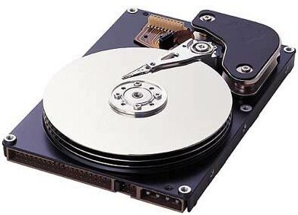
Magnetic Disk
A disk is a circular platter constructed of nonmagnetic material, called the substrate
Disk substrate coated with magnetizable material (iron oxide…)
Data are recorded (write) on and later retrieved (read) from the disk via a conducting coil, named head.
The position of heads are fixed and the platter rotates for read/write

Slide 4
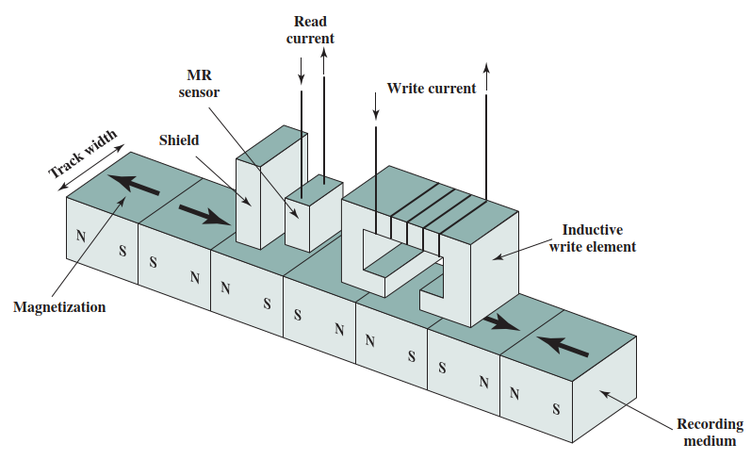
Read and Write Mechanisms
Two states: N-S or S-N represents 0 or 1
Write
  Current through coil produces magnetic field
  Pulses sent to head
  Magnetic pattern recorded on surface below
Read
  Separate read head, close to write head
  Partially shielded magneto resistive (MR) sensor
  Electrical resistance depends on direction of magnetic field

Slide 5
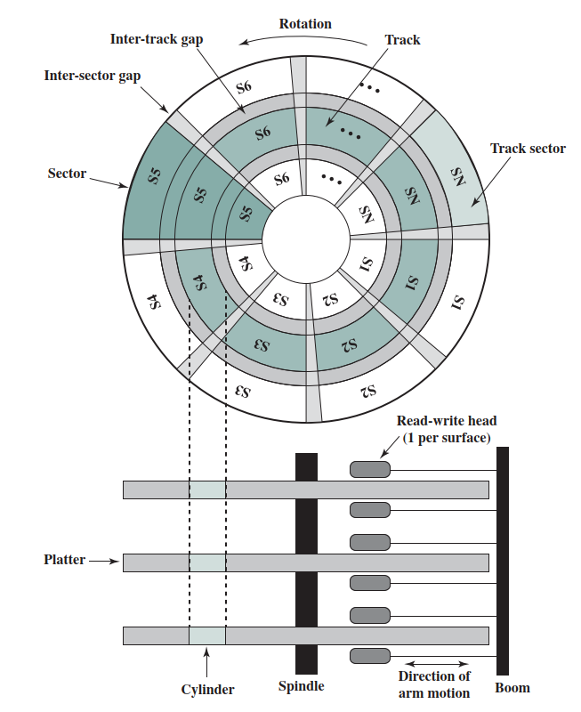
Data Organization and Formatting
Concentric rings or tracks
Each track is divided into sectors
Tracks have the same width as the head
Each sector on a track typically stores 512 bytes data
Tracks are separated by intertrack gaps
Sectors are separated by inter-sector gaps

Slide 6
Disk Velocity
If data is stored with same density across the tracks:
A bit near the center of a rotating disk passes the head slower than a bit on the outside track
Rotating speed needs to be changed or read/write time of the head needs to be changed
→ Complex circuitry for disk/head control
L₁
L₂
L₁=L₂ → T₁<T₂

Slide 7
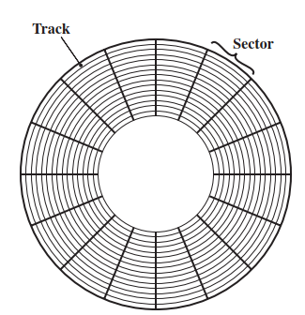
Disk Velocity
To fix the problem, two types of disks are developed:
Constant angular velocity (CAV)
Multiple zone recording (MZR)
Constant angular velocity (CAV) disk
  Disk is divided into sectors based on angular degree
  Data write/read only requires moving the head
  Advantage:
    Simple circuitry
  Drawbacks:
    Each sector stores same length of data
    Waste of space on outer tracks

Slide 8
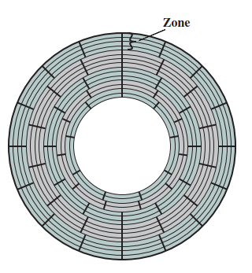
Disk Velocity
To fix the problem, two types of disks are developed:
Constant angular velocity (CAV)
Multiple zone recording (MZR)
Multiple-zone recording(MZR) disk
  The surface is divided into concentric zones
  Within a zone, the number of bits per track is same
  More sectors can be deployed on outer tracks
  Data write/read timing only changes when crossing the zones

Slide 9
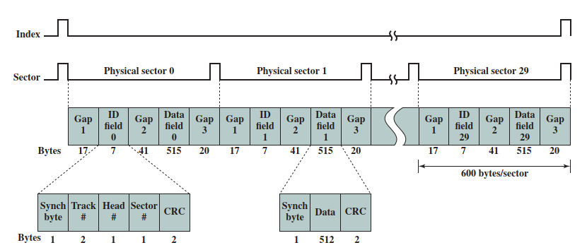
Winchester Disk Format
Seagate ST506
Must be able to identify start of track and sector
Each sector records 512 bytes data and 88 bytes overhead → 600 bytes in total

Slide 10
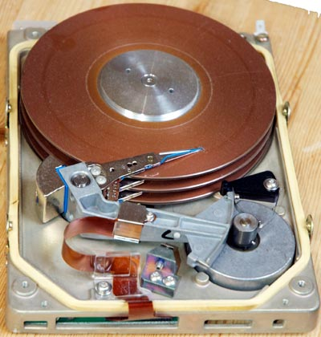
Fixed/Movable Head Disk
Fixed head
  One read-write head per track
  Heads mounted on fixed ridged arm
Movable head
  One read write head per side
  Mounted on a movable arm

Slide 11
Exercise 1:
For a hard disk with movable head, given the location (track number and sector number) and head number, what are the first steps to do to read/write data from/to the disk? (Hint: the hard disk has a mechanical structure)

Slide 12
Outline
Magnetic disk
Disk performance
Redundant Array of Independent Disks (RAID)
Solid-state drives

Slide 13
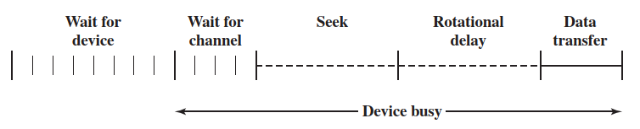
Disk Performance Parameters
Wait for device:
Wait for disk to be available
Wait for the channel:
Device is available and channel is busy (e.g. occupied by another device)
Seek time
  Moving head to correct track (impacted by the distance between the head and the track)
  T_{s}=average seek time

Slide 14
Disk Performance Parameters
Rotational latency
  Waiting for data to rotate under head
  Average: T_{r}=1/2r
  r: rotation speed, in revolutions per second
Transfer time: T = b/(rN)
  T = transfer time
  b = number of bytes to be transferred
  N = number of bytes on a track

Slide 15
Disk Performance Parameters
Total average access time:
T_{a}=T_{s}+1/(2r)+b/(rN)
  r = rotation speed, in revolutions per second
  T = transfer time
  b = number of bytes to be transferred
  N = number of bytes on a track
T_{a}

Slide 16
Exercise 2
Assuming a disk with:
An advertised average seek time of 4 ms
Rotation speed of 15,000 rpm (250 rps)
500 sectors per track with each sector stores 512 bytes
Calculate the average access time, T_{a}
T_{a}=T_{s}+1/(2r)+b/(rN)

Slide 17
Exercise 2
Assuming a disk with:
An advertised average seek time of 4 ms
Rotation speed of 15,000 rpm (250 rps)
500 sectors per track with each sector stores 512 bytes
T_{a}=T_{s}+1/(2r)+b/(rN)
What we can calculate:
T_{s} = 4 ms
T_{r} = 1/(2r)= 1/(2×250) = 2 ms
Read one sector t = 512/(250×500×512) = 0.008 ms
T_{a} = 4ms+2ms+0.008ms = 6.008 ms

Slide 18
A Timing Comparison
Assuming we are going to read 5 tracks (2500 sectors, 1.28MB):
If data are recorded on 5 adjacent tracks:
Seek time, T_{s}, only needed for the first track
T_{a} = 4ms + 5×(2ms+0.008×500ms) = 34 ms
If data are randomly distributed on the disk:
Seek time required for each sector access
Rotation time required for each sector access
T_{a} = 2500×(4ms+2ms+0.008 ms) = 15.02 s

Slide 19
A Timing Comparison
Notes:
The order in which sectors are read from the disk has a tremendous effect on the performance of hard disk
It is worthy to develop a disk scheduling algorithm to improve the performance over purely random access

Slide 20
Outline
Magnetic disk
Disk performance
Redundant Array of Independent Disks (RAID)
Solid-state drives

Slide 21
RAID
(Redundant Array of Independent Disks)
Due to physical limits, it is very difficult to improve the performance of disk further
However, multiple disks can work in parallel to improve the overall performance → RAID
7 levels in common use (RAID 0-6 with 0,1,5,6 are commonly used)
Set of physical disks viewed as single logical drive by O/S
Data distributed across physical drives (improving I/O performance)
Can use redundant capacity to store parity information (to enable the recovery of data lost due to a disk failure)

Slide 22
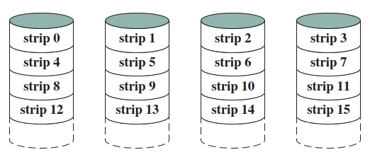
RAID 0
No redundancy
Data distributed across all disks
Round Robin striping
Increase speed
  Multiple data requests probably not on same disk
  Disks seek in parallel
  A set of data is likely to be striped across multiple disks

Slide 23

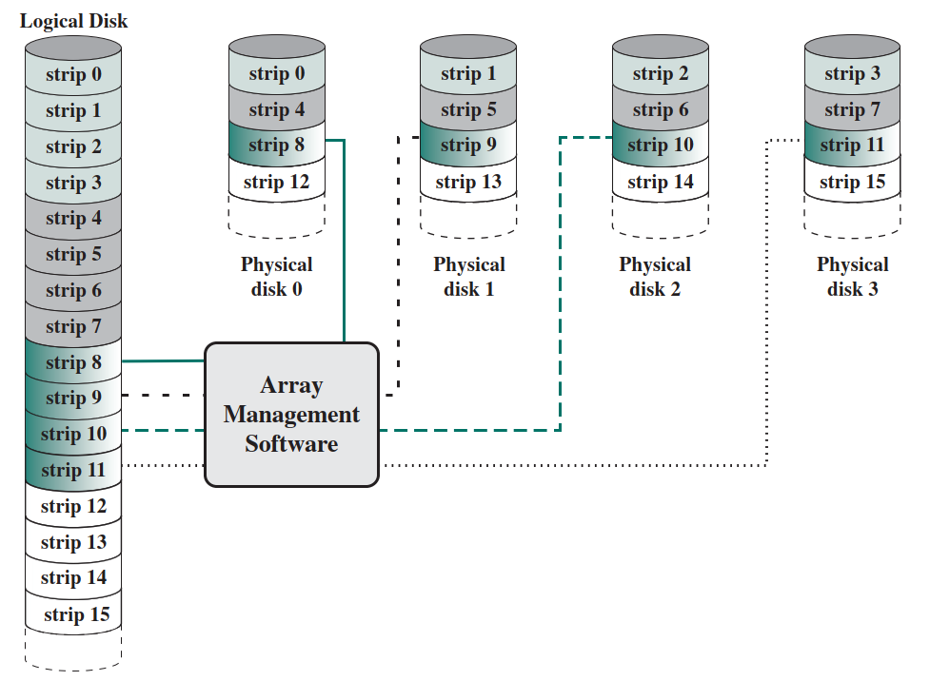
Data Mapping for RAID 0

Slide 24
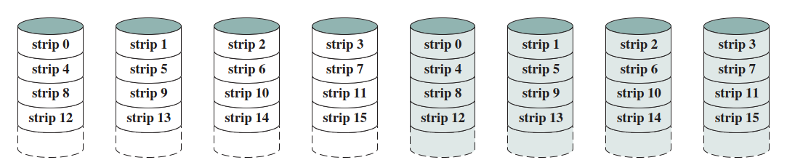
RAID 1
Mirrored Disks to provide redundancy
Data is striped across disks
2 copies of each stripe on separate disks
Read from either, write to both
Recovery is simple
  Swap faulty disk & re-mirror
Expensive to use

Slide 25
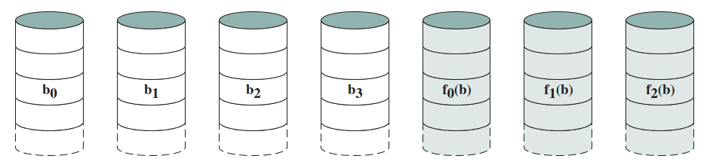
RAID 2
Disks are synchronized
Very small stripes (single byte/word)
Error correction calculated across corresponding bits on disks
Multiple parity disks store Hamming code error correction in corresponding positions
Lots of redundancy
  To be used in hash environment where many disk errors happen

Slide 26
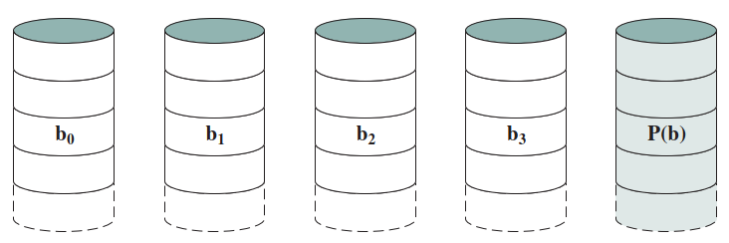
RAID 3
Only one redundant disk is required, no matter how large the disk array
Data distributed in small trips
Simple parity bit for each set of corresponding bits
Data on failed drive can be reconstructed from surviving data and parity info
High data transfer rates

Slide 27
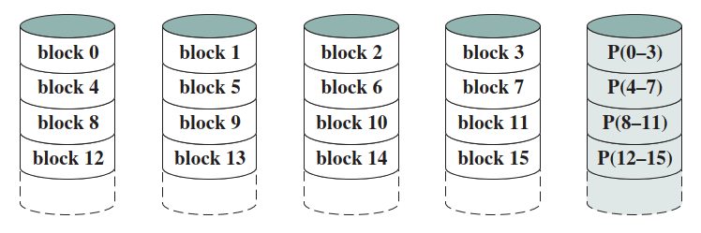
RAID 4
Each disk operates independently
Good for high I/O request rate
Data distributed in large stripes
Bit by bit parity calculated across stripes on each disk
Parity stored on parity disk
Parity disk can be the bottleneck since it is changed for every write

Slide 28
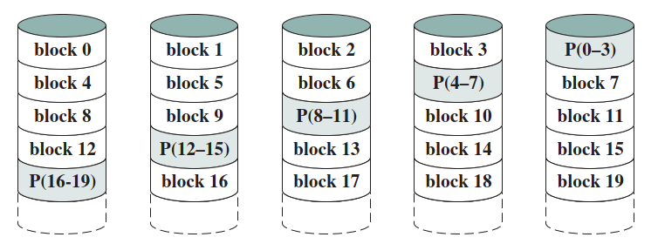
RAID 5
Like RAID 4
Parity striped across all disks
Round robin allocation for parity stripe
Avoids RAID 4 bottleneck at parity disk
Commonly used in network servers

Slide 29
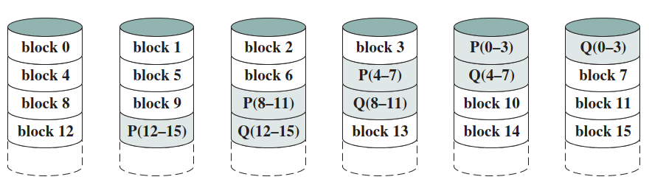
RAID 6
Two different parity calculations
Stored in separate blocks on different disks
User requirement of N disks needs N+2
High data availability
  Three disks need to fail for data loss
  Significant write penalty

Slide 30
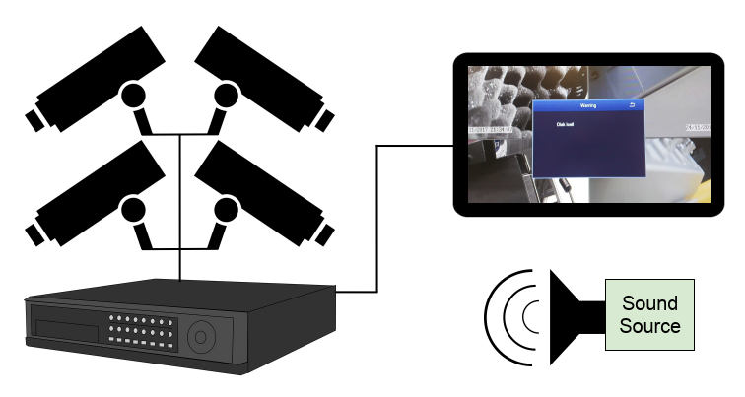
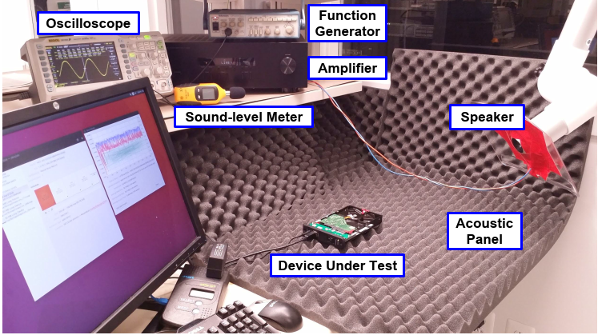
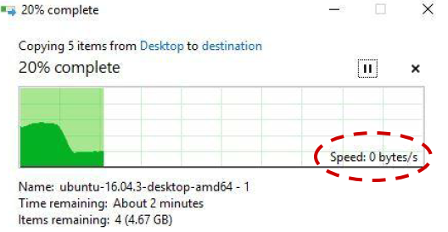
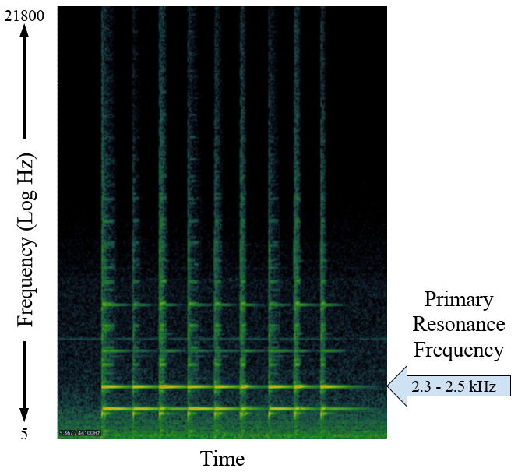
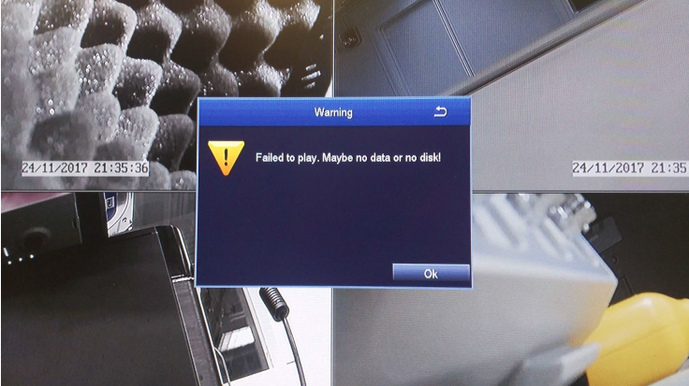
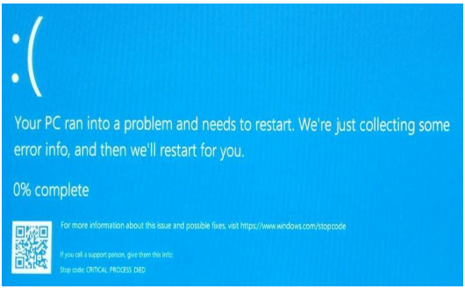
Acoustic Attack on Hard Disk Drives
A research at Purdue University: Mohammad Shahrad, Arsalan Mosenia, Liwei Song, Mung Chiang∗, David Wentzlaff, and Prateek Mittal “Acoustic Denial of Service Attacks on Hard Disk Drives”, in 2018

Slide 31
Outline
Magnetic disk
Disk performance
Redundant Array of Independent Disks (RAID)
Solid-state drives

Slide 32
Solid State Drives
Solid state drives (SSDs) is increasingly used to complement or even replace hard disk drives (HDDs)
SSDs use solid state components, like NAND flash
Advantages:
High-performance input/output operations
Less susceptible to physical shock or vibration
Longer lifespan
Lower power consumption
Quieter and cooler running capabilities
Lower access times and latency rates (10 times faster)

Slide 33
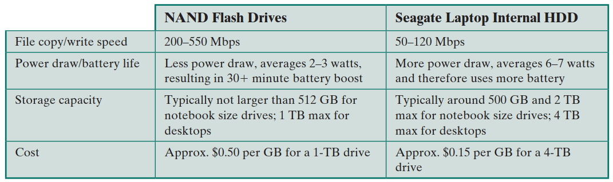
Solid State Drives

Slide 34
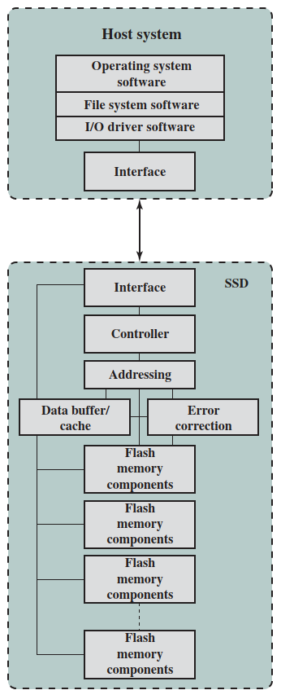
SSD Organization
Controller
Providing SSD device level interfacing and firmware execution
Addressing
Performing the selection function across the flash memory components
Data buffer/cache
High speed RAM memory components used for speed matching and to increased data throughput
Error correction
Error detection and correction
Flash memory components
Individual NAND flash chips
e.g. PCIe

Slide 35
Writing to SSDs
Flash memory is accessed in blocks with a typical size of 512 KB.
Files are stored as a set of pages, typically 4KB in length.
Writing process to SSDs:
The entire block must be read from the flash memory and placed in a RAM buffer. Then the appropriate page in the RAM buffer is updated.
Before the block can be written back to flash memory, the entire block must be erased. It is not possible to erase just one page of the memory.
The entire block is written back to the flash memory.

Slide 36
Practical Issues of SSDs
1st issue: SSD performance has a tendency to slow down as the device is used.
When a flash drive is relatively empty, the pages of that file are written on to the drive continuously, so that one or only a few blocks are affected.
Over the time, the drive become more occupied and there is more fragmentation. The writing of a new file can affect multiple blocks.
Solution → defragmentation
block 1
block 2
block 1
block 2
 |  | s
b
 |  | t
 |  |  | x
a
 | d
 |  |  | y
 | e
s | b | t | X
a | d | y | E

Slide 37
Practical Issues of SSDs
2nd issue: a flash memory becomes unusable after a certain number of writes (e.g. 100,000 writes).
Solutions:
Use a cache to delay and group write operation
Evenly distribute writes across blocks
Sophisticated bad-block management techniques

Slide 38
Thank you!
Q&A

